Slide 1

ONLINE CODE COMPILER FOR WEB DEVELOPMENT
STUDENT NAME :- DHEERAJ NAIDU
ROLL NUMBER :- 2520080067
CLUSTER :- 1

Slide 2
Abstract
The Online Code Compiler for Web Development is a web-based platform designed to help users write, compile, and execute web development code directly through a browser. The system allows users to enter HTML, CSS, and JavaScript code and instantly view the output without installing any software on their computers. The platform provides an integrated coding environment where users can write code in a structured editor and view the results in real time. This system is especially useful for students and beginner developers who want to practice web development concepts quickly and efficiently. By combining modern web technologies, the platform provides a simple, accessible, and effective way to test and execute web code online.

Slide 3
Existing System Analysis
In the existing system, developers typically use traditional code editors or Integrated Development Environments (IDEs) such as Visual Studio Code or other local software installed on their computers. These tools require installation, configuration, and sometimes additional plugins before users can start coding. For beginners, setting up the development environment can be difficult and time-consuming. Users must install multiple tools and continuously switch between the code editor and browser to test the output. These limitations make the learning process more complex and less convenient for new programmers.

Slide 4
Proposed System Overview
The proposed system, Online Code Compiler for Web Development, is designed to simplify the coding process by providing an integrated web-based coding environment. In this system, users can write HTML, CSS, and JavaScript code directly in an online editor and execute the program instantly. The platform displays the output of the code in a separate output section, allowing users to see the results in real time. This eliminates the need for installing external software or switching between multiple applications. The system improves the coding experience by making web development practice faster, easier, and more accessible.

Slide 5
System Architecture
The Online Code Compiler for Web Development follows a simple web-based architecture consisting of three main layers: the User Interface Layer, the Processing Layer, and the Output Layer. User Interface Layer (Frontend) This layer is developed using HTML and CSS and provides the coding interface for users. It includes the code editor where users can write HTML, CSS, and JavaScript code. Processing Layer (Application Logic) This layer is implemented using JavaScript. It processes the code entered by the user and prepares it for execution within the browser environment. Output Layer This layer displays the result of the executed code. The output window shows the compiled HTML, CSS, and JavaScript results in real time, allowing users to view the final webpage instantly.

Slide 6
Project Modules
Code Editor Module Allows users to write and edit web development code such as HTML, CSS, and JavaScript. Code Execution Module Processes the written code and executes it directly within the browser. Output Display Module Displays the result of the executed code in a real-time output window. User Interface Module Provides an interactive and easy-to-use environment for writing and testing code.

Slide 7
Project Objectives
Efficient Code Execution Provide a platform that enables users to write and run web development code quickly. Simplified Learning Environment Help beginners learn web development without complicated setup processes. Real-Time Output Display Allow users to see the results of their code immediately after execution. Improve Coding Practice Provide a convenient environment for experimenting with web development concepts and improving programming skills.

Slide 8
Course Outcomes (CO’s Attainment)
CO1: Web Development Apply HTML, CSS, and JavaScript to design and develop interactive web applications. CO2: Programming Concepts Demonstrate understanding of programming logic and execution in a browser environment. CO3: User Interface Design Develop an intuitive and user-friendly interface for writing and testing code. CO4: Technology Integration Integrate different web technologies to create a functional online compiler platform. CO5: Problem Solving and System Design Demonstrate effective problem-solving skills through the design and implementation of a practical software system.

Slide 9
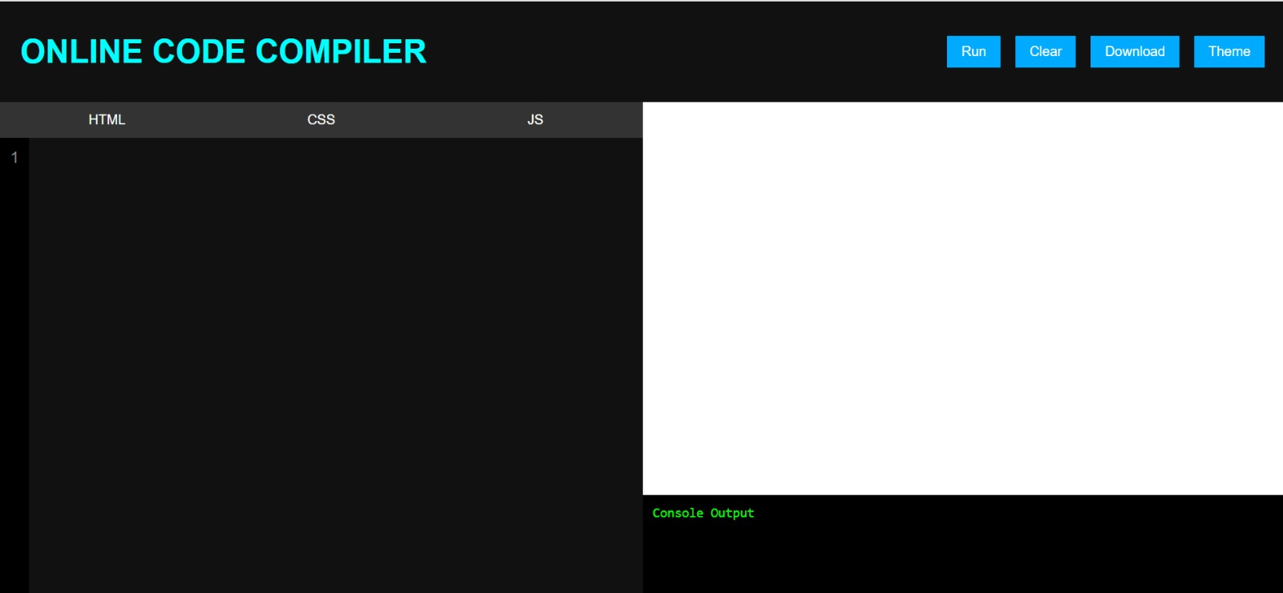
Screenshots for FWD & DSA

Slide 10
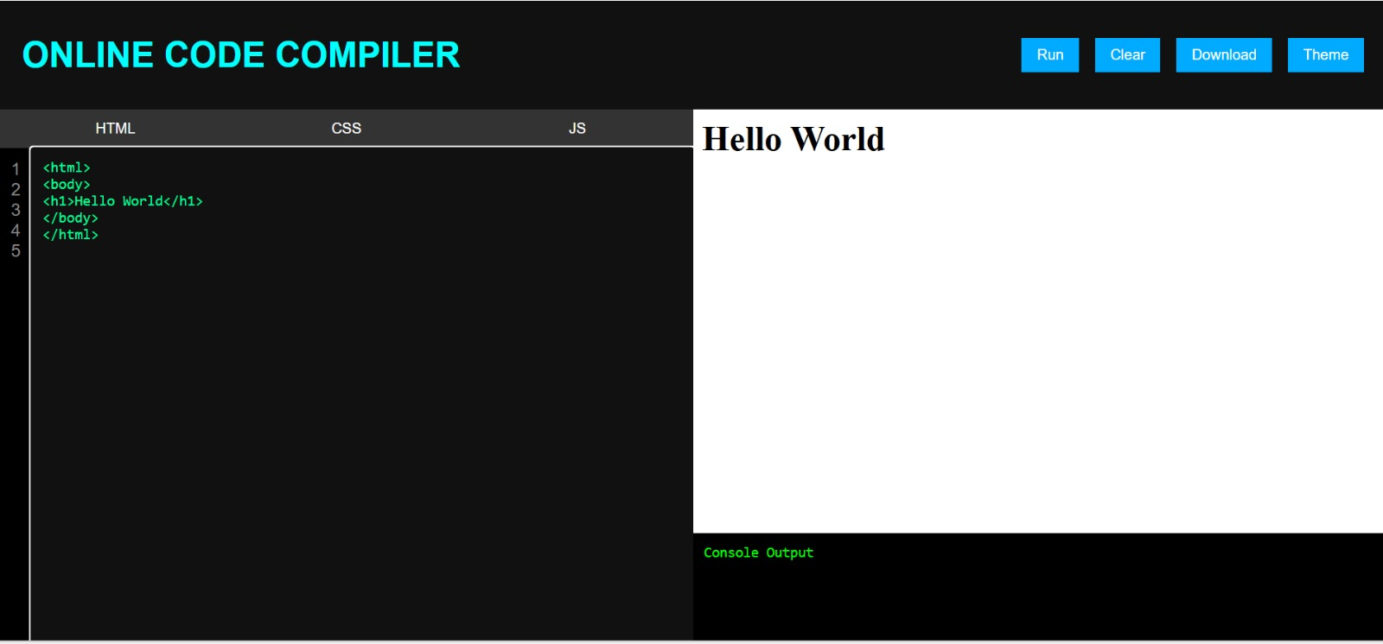
Screenshots for FWD & DSA

Slide 11
Conclusion
The Online Code Compiler for Web Development provides a simple and efficient platform for writing and executing web development code directly in the browser. The system eliminates the need for installing complex development tools and simplifies the learning process for beginners. By integrating HTML, CSS, and JavaScript within a single platform, the project creates a convenient environment for practicing and testing web development concepts.

Slide 12

Geo-Tag Photos

Slide 13
THANK YOU

